Slide 1
Electric Power Usage Forecasting
By
Kunal Dhande

Slide 2
Task
With given weather data (temperature, wind, rain, humidity, precipitation, etc.) and past electricity usage (in terms of kw/hr.), predict future usage of power based on the weather conditions.
Electric power demand prediction is a necessary process for efficient resource management in a smart grid.
If performed accurately it can save millions of dollars for power companies.

Slide 3
Dataset
Weather data of 8 months (Jan – Aug 2016) from http://api.wunderground.com and respective power usage for the time period from http://www.comed.com
We processed the weather data and power usage that gave us a vocabulary of size 6.
So, our dataset has 5850 rows and 6 columns

Slide 4
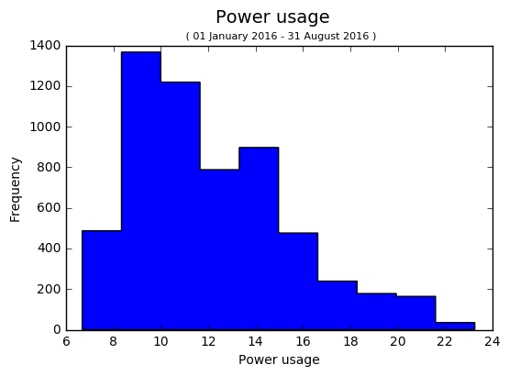
Visualization of Power Usage (Target)
Mean: 12.171
Variance: 10.877
Hourly Power Usage from 1 Jan to 31 August 2016

Slide 5
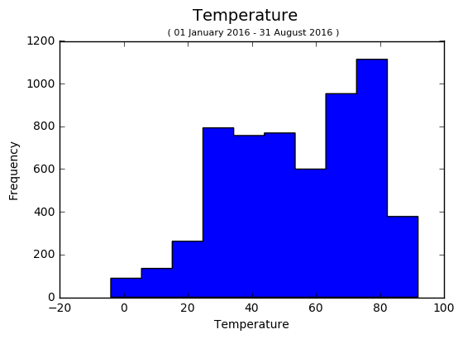
Visualization of Temperature (feature)
Mean: 53.915
Variance: 457.261
Hourly Temperature from 1 Jan to 31 August 2016

Slide 6
Model Selection Results
Models
Locally Weighted Regression (LWR)
MLP Regression
Kernel Ridge Regression - Laplacian
Support Vector Regression – RBF
We used Negative Mean Absolute Error (MAE) and Negative Mean Square Error (MSE) because -
Both mean squared error (MSE) and mean absolute error (MAE) are used in predictive modeling.
MAE is more robust to outliers since it does not make use of square.
MSE is more useful if we are concerned about large errors whose consequences are much bigger than equivalent smaller ones.

Slide 7
Model Selection Results
10-fold cross validation Results
Model | Parameters | Performance
Locally Weighted Regression (LWR) | - | Negative MAE : 2.74760190769 Negative MSE : 13.76786027565
MLP regression | hidden_layer_sizes = 50, alpha=0.0007, random_state=1, activation='identity', warm_start=True | Negative MAE : 2.107882568 Negative MSE : 6.92295378724
Kernel Ridge Regression - Laplacian | kernel='laplacian', alpha=0.1, gamma=0.1 | Negative MAE : 1.57358798053 Negative MSE : 5.67602351394
Support Vector Regression - RBF | kernel='rbf', C=1e3 | Negative MAE : 1.322480129185 Negative MSE : 5.00180266547
Best model and parameter setting was Support Vector Regression with kernel ‘RBF’

Slide 8
Interesting/unexpected cases
If there is sudden huge change in weather condition then the model does not gives accurate prediction.
This might be because the model is not trained with enough data that it can not understand these sudden changes in weather.
And sometimes it is difficult to predict power usage based on weather, there are other factors that also affect power usage, for example, festivals, events.

Slide 9
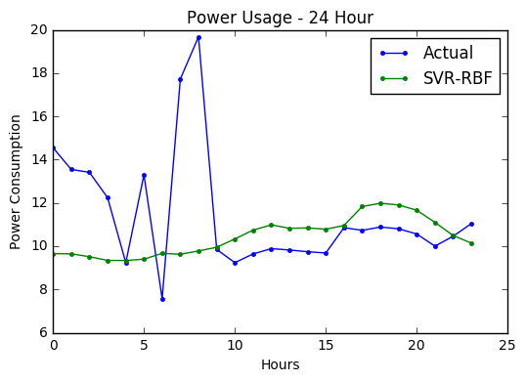
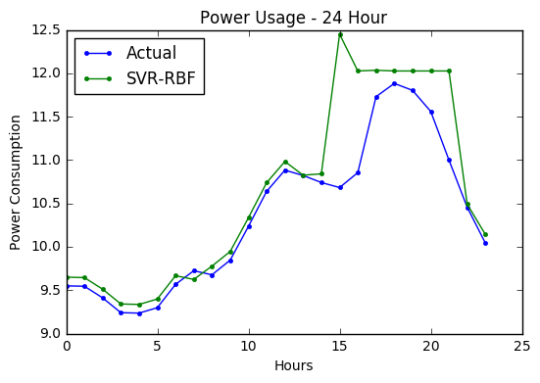
Interesting/unexpected cases (Continued)
(a)
Due to some occasion (E.g., festivals, events) excess use of power
(b)
Sudden weather change (temperature decreases from 28 to 16 in 5 hrs)

